Slide 1
Electricity demand prediction
Problem Type Regression

Slide 2

Power Sector facing multifront crises from power generation, demand and customer service
Warmer and more humid weather due to climate change and electricity wastage causes high demand takes place, hence demand response is slow followed by generators got tripped frequently and supply shortage occurs
In addition, heavy system losses occurs due to inefficient transmission, distribution losses and fraudulent connections
Consumer are paying high prices still having load shading due to inefficient power management.
Revenue shortage occurs
Problem Statement
Power Management seeks
Hourly demand forecast for short term, mid term and long term
Optimized generation distribution to reduce high stress on genaretors.
Optimized power distribution to reduce load shading

Slide 3
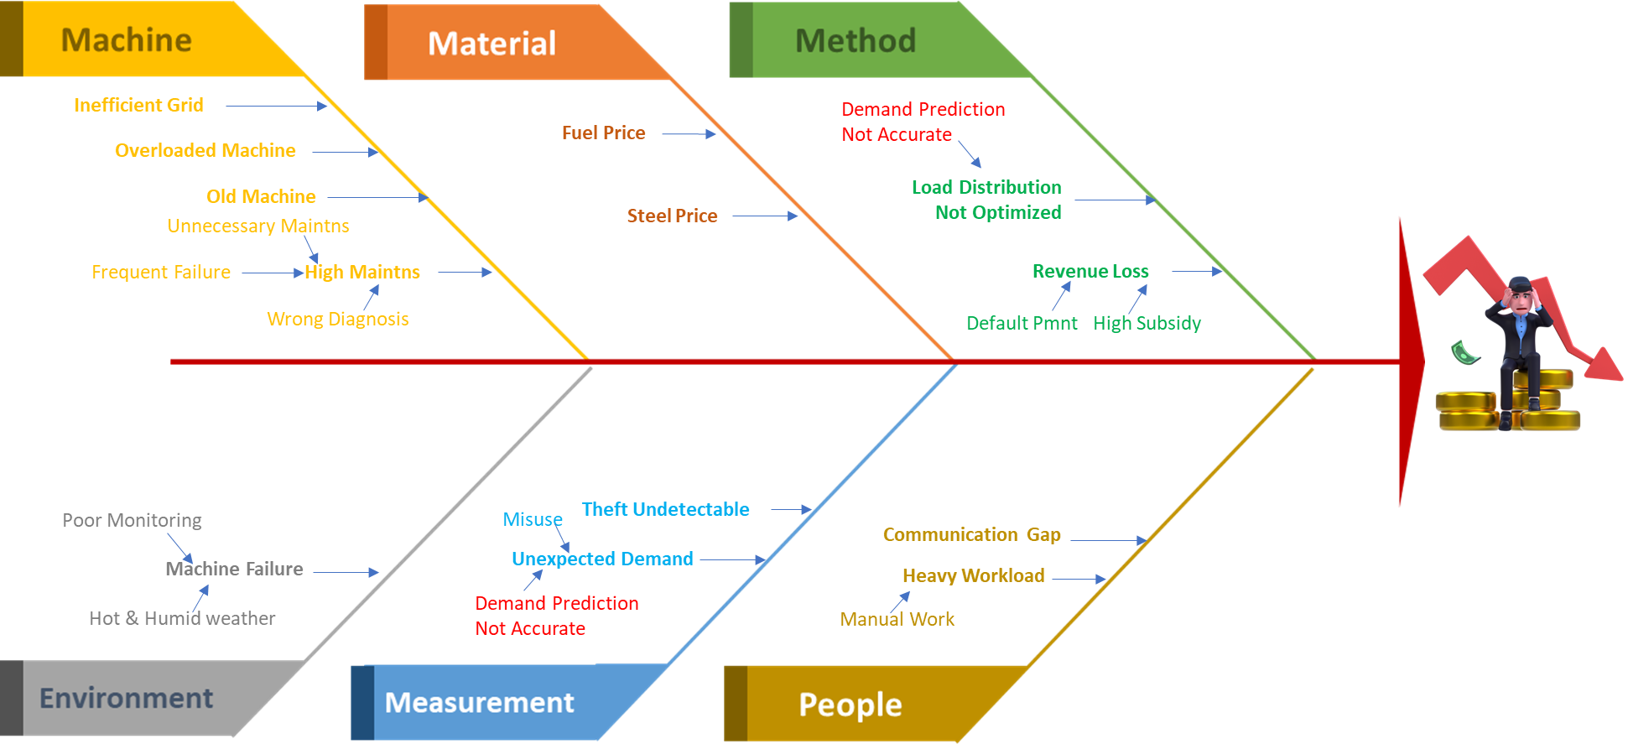
Root causes for losses of power department
Target = Electricity Demand
Root Cause
Helps division of
Generation
Optimized Load on Generators
Transmission & Distribution
Optimize Load Distribution
Finance
Customized pricing
Reduce Subsidy
Procurement, Supply chain early preparedness
Customer Service
Minimizes Load Shading
Energy saving advisory
Root Cause

Slide 4
Analytics Data Requirement
Electricity Demand Prediction
Weather
Forecast
Electricity Consumption
Weather parameters i.e.
Temperature,
Humidity
precipitation,
wind speed,
wind direction etc
Hourly
Daily Consumption data
Zone or Individual customer level

Slide 5
Received Data
Location, Date, Weather and Consumption

Slide 6
Data
Observation
Connect Data
Under Energy Create Demand Prediction solution for regression
Upload Data from Source CSV
File: electricity_load_train
Analysis Result
Check top left Cell 1
for Test and actual result to assess whether test result patterns capture actual patterns
Check histograms whether distribution is skewed
Check Anomaly plot
Check top right Cell 2
Check prediction accuracy in the error chart
Check preliminary variable importance
Check correlation chart
Check Bottom Left Cell 3
Check result column “predicted_usage_LR” and “usage column”
Check Bottom Right Cell 4
Check Variable statistics
Write down variables p-value<.05, pearson correlation >0.50
Check Validation result
Data Preprocess
Clean Data
Create Hour Column
Select Item and Target
Select Region as Item
Select Usage as your target
Click yes to the pop up

Slide 7
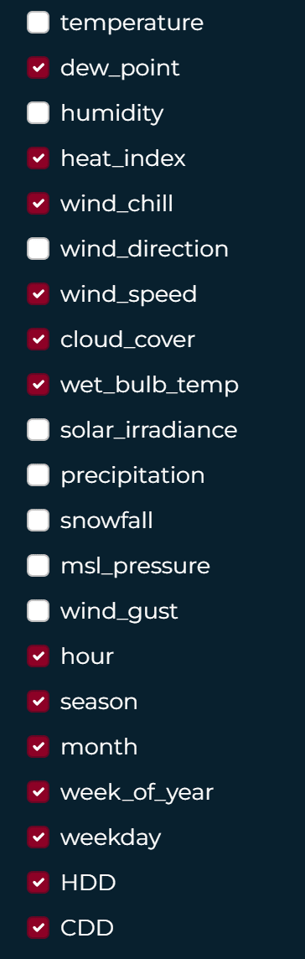
Build Model
Variable Processing
Unselect Humidity, winddir, windspeed, msl pressure, windgust, snowfall
Create season
Create Calendar
shuffle
unselect month
HDD = Temperature above 65
CDD = Temperature below 60
HDD= np.where(df["temperature"]>69,df["temperature"]-70,0)
CDD= np.where(df["temperature"]<55, 55 - df["temperature"],0)
Create science based variable
• Create HDD and cdd check scatter
• Select HDD

Slide 8
Decision to create
Generation
Transmission
Distribution
Extra charge
If Load > threshold
then Activate Backup Gen 1
If Load < threshold
then Reduce Gen 2
If Load > threshold
then Estimate Load shading hours.
Ld. Shd. Hours = (Load-threshold)/hourly generation
If Load > Avg. Daily load
then Calculate Extra Fee
If Extra Fee > 0
Calculate Extra Fee
Backup Generator = np.where(df["usage_XGB"]>12000, (df["usage_XGB"]-12000)/1500, "None")
Load Shading Hour= np.where(df["usage_XGB"]>12000, (df["usage_XGB"]-12000)/1500, "None")
Wastage = np.where(df["usage_XGB"]>12000, (df["usage_XGB"]-12000), 0)
Wastage Fee (Lakh) = np.where(df[“Wastage"]>12000, (df[“Wastage*2/100, 0)

Slide 9

Thank You
someone@example.com

